Slide 1
UBS Quant Hackathon Presentation
IC Underground

Slide 2
Initial Approach
Only two pieces of data: bb_live and Carry12: Carry Adjusted Price/Return and 1 year carry values
Decided to create two trading signals: a signal for the overall returns, and a signal for the carry
Each Signal would assign weights that would sum up to 1
These signals (weights) would then be combined together with a specified ratio: alpha
Final Signal=(Returns Signal + (Carry Signal *alpha))/(1+alpha)

Slide 3
Carry Signal: Machine Learning Approach
Tried to predict the forward carry from past data: Regressions/Classifications
Features were created by aggregating SMAs of 10 to 120 rolling windows, in increments of 10, resulting in 12 features
DataFrame was split 70-30 as train-test
Linear Regression and Lasso Regression was tested on the dataframe, yielding inaccurate results (i.e. true positive carry was predicted to be negative and vice-versa, values however were in the same order of magnitude)
Classification algorithms were fitted on the training dataset in order to binary predict a positive/negative carry, but accuracy was quite low (80%) and more importantly there were a high number of FP (i.e. actual/true negative carry was found to be positive, yielding massive losses this way)

Slide 4
Carry Signal: Rolling Average
The signal used instead was the 50 day rolling average of the Carry Divided by the Carry Volatility
In testing it was found that restricting the signal to be long only, worked better

Slide 5
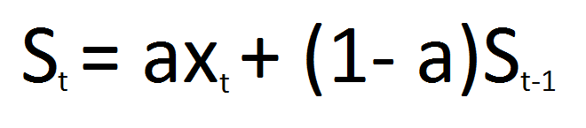

Volatility Clustering
Getting a good volatility estimation was key
To get better estimate of current volatility, Conditional Volatility should be used
Conditional Volatility is based on past volatility values -(ie. Not just total volatility of time period)
Two methods that can be used estimate Conditional Volatility: EWMA and GARCH
EWMA is a moving average, where more weight is put on more recent terms
GARCH(1,1) differs as it includes a mean reversion term as well. Because of this it is considered more accurate
EWMA can be thought as of a specialised case of GARCH(1,1).

Slide 6
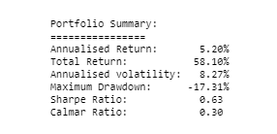
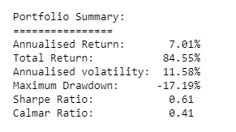
Volatility Prediction Comparison
The two methods were compared, tested on Returns signal
GARCH(1,1) requires fitting/regression, in EWMA a weighting is specified
Using GARCH, volatility could be predicted on a weekly basis vs daily for EWMA due to processing time constraint
GARCH gave better sharpe, but less reactive to daily changes in volatility
Due to the fact only weekly could be used with GARCH, EWMA was selected
EWMA
GARCH(1,1)

Slide 7
Returns Signal
Create a signal based on the returns of the currencies
Research suggested that strategies only based on volatility work better than strategies based on return and volatility for FX
Initially an inverse volatility signal was considered (ie. more weight when lower vol)
Surprisingly however, the opposite strategy worked better (more weight when higher vol)
Potentially due to the fact that the returns are carry adjusted
Positive Signal for stocks which have increased in price over two months, and vice versa

Slide 8
Dynamically Adjusted Leverage: Covariance Matrix
Desire existed to dynamically adjust leverage based on current market conditions
Initially used a covariance matrix to find volatility of current position, and then scaled leverage to target desired volatility
Very effective at maintaining certain volatility
Not so much for achieving a good sharpe ratio...
Portfolio optimization was considered, but this would take too long (Training Time constraint)

Slide 9
Dynamically Adjusted Leverage: Signal Booster/Volatility adjusted
Signal Strength based method then tried
Increasing or decreasing leverage based on how strong signal is in comparison to past signals
Achieved 30% increase in Sharpe from example notebook and improved Calmar Ratio
Detrimental effect observed when applied to returns signal→ Adjust Leverage based on inverse volatility
This led to significant improvements in Sharpe and Calmar Ratio

Slide 10
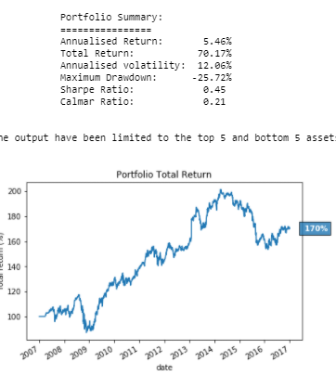
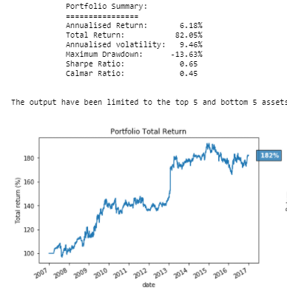
Signal Results
Returns Signal
Carry Signal
Returns Signal has better Sharpe and Calmar
However Carry Signal is more consistent
Returns Signal was less susceptible to downturn
Both Signals combined in 1:1 Ratio

Slide 11
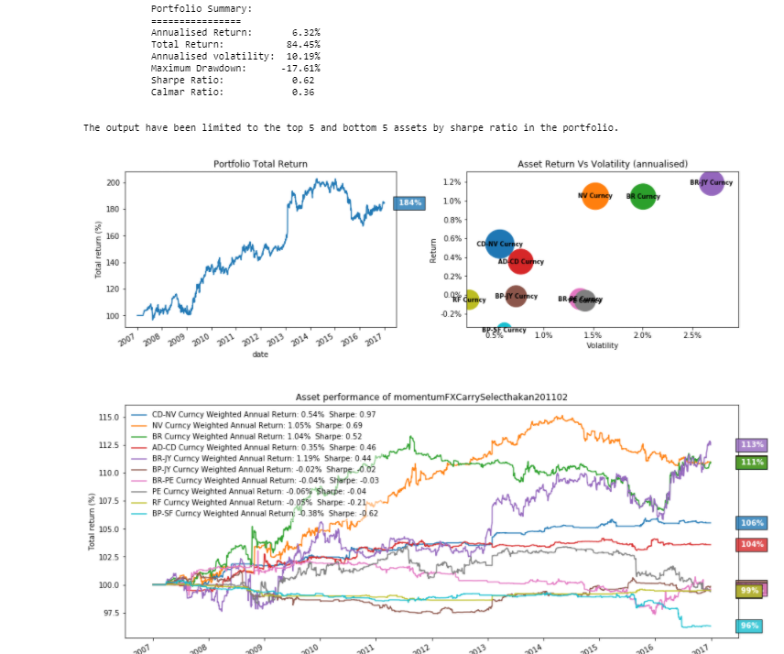
Final Results

